Slide 1
Lecture 05 – Part A First Order Logic (FOL)
Dr. Shazzad Hosain
Department of EECS
North South Universtiy
shazzad@northsouth.edu

Slide 2
Knowledge Representation & Reasoning
Introduction
Propositional logic is declarative
Propositional logic is compositional: meaning of B1,1 ∧ P1,2 is derived from meaning of B1,1 and of P1,2
Meaning propositional logic is context-independent unlike natural language, where meaning depends on context
Propositional logic has limited expressive power unlike natural language
e.g., cannot say "pits cause breezes in adjacent squares“
(except by writing one sentence for each square)
‹#›

Slide 3
Knowledge Representation & Reasoning
From propositional logic (PL) to First order logic (FOL)
Examples of things we can say:
All men are mortal:
∀x Man(x) ⇒Mortal(x)
Everybody loves somebody
∀x ∃y Loves(x, y)
The meaning of the word “above”
∀ x ∀ y above(x,y) ⇔(on(x,y) ∨ ∃z (on(x,z) ∧ above(z,y))
‹#›

Slide 4
Knowledge Representation & Reasoning
First Order Logic
Whereas propositional logic assumes the world contains facts, first-order logic (like natural language) assumes the world contains:
Objects: people, houses, numbers, colors, …
Relations: red, round, prime, brother of, bigger than, part of, …
Functions: Sqrt, Plus, …
Can express the following:
Squares neighboring the Wumpus are smelly;
Squares neighboring a pit are breezy.
‹#›

Slide 5
Knowledge Representation & Reasoning
Syntax of FOL
User defines these primitives:
Constant symbols (i.e., the "individuals" in the world) e.g., Mary, 3
Function symbols (mapping individuals to individuals) e.g., father-of(Mary) = John, colorof(Sky) = Blue
Predicate/relation symbols (mapping from individuals to truth values) e.g., greater(5,3),
green(apple), color(apple, Green)
‹#›

Slide 6
Knowledge Representation & Reasoning
Syntax of FOL
FOL supplies these primitives:
Variable symbols. e.g., x,y
Connectives. Same as in PL: ⇔,∧,∨, ⇒
Equality =
Quantifiers: Universal (∀) and Existential (∃)
A legitimate expression of predicate calculus is called a well-formed formula (wff) or, simply, a sentence.
‹#›

Slide 7
Knowledge Representation & Reasoning
Syntax of FOL
Quantifiers: Universal (∀) and Existential (∃)
Allow us to express properties of collections of objects instead of enumerating objects by name
Universal: “for all”:
∀<variables> <sentence>
Existential: “there exists”
∃<variables> <sentence>
‹#›

Slide 8
Knowledge Representation & Reasoning
Syntax of FOL: Constant Symbols
A symbol, e.g. Wumpus, Ali.
Each constant symbol names exactly one object in a universe of discourse, but:
not all objects have symbol names;
some objects have several symbol names.
Usually denoted with upper-case first letter.
‹#›

Slide 9
Knowledge Representation & Reasoning
Syntax of FOL: Variables
Used to represent objects or properties of objects without explicitly naming the object.
Usually lower case.
For example:
x
father
square
‹#›

Slide 10
Knowledge Representation & Reasoning
Syntax of FOL: Relation (Predicate) Symbols
A predicate symbol is used to represent a relation in a universe of discourse.
The sentence
Relation(Term1, Term2,…)
is either TRUE or FALSE depending on whether Relation holds of Term1, Term2,…
To write “Malek wrote Mina” in a universe of discourse of names and written works:
Wrote(Malek, Mina)
This sentence is true in the intended interpretation.
Another example:
Instructor (CSE531, Shazzad)
‹#›

Slide 11
Knowledge Representation & Reasoning
Syntax of FOL: Function symbols
Functions talk about the binary relation of pairs of objects.
For example, the Father relation might represent all pairs of persons in father-daughter or father-son relationships:
Father(Ali) Refers to the father of Ali
Father(x) Refers to the father of variable x
‹#›

Slide 12
Knowledge Representation & Reasoning
Syntax of FOL: properties of quantifiers
∀ x ∀ y is the same as ∀ y ∀ x
∃ x ∃ y is the same as ∃ y ∃ x
∃ x ∀ y is not the same as ∀ y ∃ x:
∃ x ∀ y Loves(x,y)
“There is a person who loves everyone in the world”
∀ y ∃ x Loves(x,y)
“Everyone in the world is loved by at least one person”
Quantifier duality: each can be expressed using the other
∀ x Likes(x, IceCream) ≡ ¬ ∃ x ¬Likes(x, IceCream)
∃ x Likes(x, Broccoli) ≡ ¬ ∀ x ¬Likes(x, Broccoli)
‹#›

Slide 13
Quantifier Scope
Switching the order of universal quantifiers does not change the meaning:
(∀x)(∀y)P(x,y) ↔ (∀y)(∀x) P(x,y)
Similarly, you can switch the order of existential quantifiers:
(∃x)(∃y)P(x,y) ↔ (∃y)(∃x) P(x,y)
Switching the order of universals and existentials does change meaning:
Everyone likes someone: (∀x)(∃y) likes(x,y)
Someone is liked by everyone: (∃y)(∀x) likes(x,y)
Notes:
‹#›

Slide 14
Connections between All and Exists
We can relate sentences involving ∀ and ∃ using De Morgan’s laws:
(∀x) ¬P(x) ↔ ¬(∃x) P(x)
¬(∀x) P ↔ (∃x) ¬P(x)
(∀x) P(x) ↔ ¬ (∃x) ¬P(x)
(∃x) P(x) ↔ ¬(∀x) ¬P(x)

Slide 15
A Common Mistake
Typically, ⇒ is the main connective with ∀
Common mistake: using ∧ as the main connective with ∀:
∀x At(x,NSU) ∧ Smart(x)
means “Everyone is at NSU and everyone is smart”

Slide 16
Knowledge Representation & Reasoning
Syntax of FOL: Atomic sentence
Atomic sentence = predicate (term1,...,termn)
or term1 = term2
Term = function (term1,...,termn)
or constant or variable
Example terms:
Brother(Ali , Mohamed)
Greater(Length(x), Length(y))
‹#›

Slide 17
Knowledge Representation & Reasoning
Syntax of FOL: Complex sentence
Complex sentences are made from atomic sentences using connectives and by applying quantifiers.
Examples:
Sibling(Ali, Mohamed) ⇒ Sibling(Mohamed, Ali)
greater(1, 2) ∨ less-or-equal(1, 2)
∀ x, y Sibling(x, y) ⇒ Sibling(y, x)
‹#›

Slide 18
Translating English to FOL …
No purple mushroom is poisonous. ~(∃ x) purple(x) ^ mushroom(x) ^ poisonous(x) or, equivalently, (∀ x) (mushroom(x) ^ purple(x)) => ~poisonous(x)
There are exactly two purple mushrooms. (∃x)(∃y) mushroom(x) ^ purple(x) ^ mushroom(y) ^ purple(y) ^ ~(x=y) ^ (∀ z) (mushroom(z) ^ purple(z)) => ((x=z) v (y=z))
Deb is not tall. ~tall(Deb)
X is above Y if X is on directly on top of Y or else there is a pile of one or more other objects directly on top of one another starting with X and ending with Y. (∀x)(∃y) above(x,y) <=> (on(x,y) v (∃z) (on(x,z) ^ above(z,y)))

Slide 19
Translating English to FOL …
Every gardener likes the sun.
∀x gardener(x) → likes(x, Sun)
You can fool some of the people all of the time.
∃x ∀t person(x) ∧time(t) → can-fool(x, t)
You can fool all of the people some of the time.
∀x ∃t (person(x) → time(t) ∧can-fool(x, t))
∀x (person(x) → ∃t (time(t) ∧can-fool(x, t))
Equivalent

Slide 20
Example: Hoofers Club
Problem Statement: Tony, Shi-Kuo and Ellen belong to the Hoofers Club. Every member of the Hoofers Club is either a skier or a mountain climber or both. No mountain climber likes rain, and all skiers like snow. Ellen dislikes whatever Tony likes and likes whatever Tony dislikes. Tony likes rain and snow.
Query: Is there a member of the Hoofers Club who is a mountain climber but not a skier?

Slide 21
Translation into FOL Senteces
Problem Statement: Tony, Shi-Kuo and Ellen belong to the Hoofers Club. Every member of the Hoofers Club is either a skier or a mountain climber or both. No mountain climber likes rain, and all skiers like snow. Ellen dislikes whatever Tony likes and likes whatever Tony dislikes. Tony likes rain and snow.
Query: Is there a member of the Hoofers Club who is a mountain climber but not a skier?
Let S(x) mean x is a skier, M(x) mean x is a mountain climber, and L(x,y) mean x likes y, where the domain of the first variable is Hoofers Club members, and the domain of the second variable is snow and rain. We can now translate the above English sentences into the following FOL wffs:
(∀x) S(x) v M(x)
~(∃x) M(x) ^ L(x, Rain)
(∀x) S(x) => L(x, Snow)
(∀y) L(Ellen, y) <=> ~L(Tony, y)
L(Tony, Rain)
L(Tony, Snow)
Query: (∃x) M(x) ^ ~S(x)
Negation of the Query: ~(∃x) M(x) ^ ~S(x)

Slide 22
Knowledge Representation & Reasoning
Syntax of First Order Logic
Sentence → Atomic Sentence
|(sentence connective Sentence)
| Quantifier variable,… Sentence
| ¬ Sentence
Atomic Sentence → Predicate (Term,…) |Term=Term
Term → Function(Term,…) | Constant |variable
Connective → ⇔ | ∧ | ∨ | ⇒
Quantifier → ∀ | ∃
Constant → A |X₁…
Variable → a | x | s | …
Predicate → Before | hascolor | ….
Function → Mother | Leftleg |…
‹#›

Slide 23
Inference in FOL
Reducing first-order inference to propositional inference
‹#›

Slide 24
Knowledge Representation & Reasoning
Inference in First Order Logic
Inference in FOL can be performed by:
Reducing first-order inference to propositional inference
Unification
Generalized Modus Ponens
Resolution
Forward chaining
Backward chaining
‹#›

Slide 25
Knowledge Representation & Reasoning
Inference in First Order Logic
From FOL to PL
First order inference can be done by converting the knowledge base to PL and using propositional inference.
Two questions??
How to convert universal quantifiers?
Replace variable by ground term.
How to convert existential quantifiers?
Skolemization.
‹#›

Slide 26
Knowledge Representation & Reasoning
Inference in First Order Logic
Substitution
Given a sentence α and binding list σ, the result of applying the substitution σ to α is denoted by Subst(σ, α).
Example:
σ = {x/Sam, y/Pam} α = Likes(x,y)
Subst({x/Sam, y/Pam}, Likes(x,y)) = Likes(Sam, Pam)
‹#›

Slide 27
Universal instantiation (UI)
Notation: Subst({v/g}, α) means the result of substituting g for v in sentence α
Every instantiation of a universally quantified sentence is entailed by it:
∀v α
Subst({v/g}, α)
for any variable v and ground term g
E.g., ∀x King(x) ∧ Greedy(x) ⇒ Evil(x) yields
King(John) ∧ Greedy(John) ⇒ Evil(John), {x/John}
King(Richard) ∧ Greedy(Richard) ⇒ Evil(Richard), {x/Richard}
King(Father(John)) ∧ Greedy(Father(John)) ⇒ Evil(Father(John)), {x/Father(John)}

Slide 28
Existential instantiation (EI)
For any sentence α, variable v, and constant symbol k (that does not appear elsewhere in the knowledge base):
∃v α
Subst({v/k}, α) E.g., ∃x Crown(x) ∧ OnHead(x,John) yields: Crown(C₁) ∧ OnHead(C₁,John)
where C₁ is a new constant symbol, called a Skolem constant
Existential and universal instantiation allows to “propositionalize” any FOL sentence or KB
EI produces one instantiation per EQ sentence
UI produces a whole set of instantiated sentences per UQ sentence

Slide 29
Reduction to propositional form
Suppose the KB contains the following:
∀x King(x) ∧ Greedy(x) ⇒ Evil(x)
Father (x)
King (John)
Greedy (John)
Brother (Richard, John)
Instantiating the universal sentence in all possible ways, we have:
King (John) ∧ Greedy(John) ⇒ Evil(John)
King (Richard) ∧ Greedy(Richard) ⇒ Evil(Richard)
King (John)
Greedy (John)
Brother (Richard, John)
The new KB is propositionalized: propositional symbols are
King (John), Greedy (John), Evil (John), King (Richard), etc

Slide 30
Reduction continued
Every FOL KB can be propositionalized so as to preserve entailment
A ground sentence is entailed by new KB iff entailed by original KB
Idea for doing inference in FOL:
propositionalize KB and query
apply resolution-based inference
return result
Problem: with function symbols, there are infinitely many ground terms,
e.g., Father(Father(Father(John))), etc

Slide 31
Reduction continued
Theorem: Herbrand (1930). If a sentence α is entailed by a FOL KB, it is entailed by a finite subset of the propositionalized KB Idea: For n = 0 to ∞ do
create a propositional KB by instantiating with depth-$n$ terms
see if α is entailed by this KB
Example
∀x King(x) ∧ Greedy(x) ⇒ Evil(x)
Father(x)
King(John)
Greedy(Richard)
Brother(Richard,John)
Query Evil(X)?

Slide 32
∀x King(x) ∧ Greedy(x) ⇒ Evil(x)
Father(x)
King(John)
Greedy(Richard)
Brother(Richard, John)
Depth 0
Father(John)
Father(Richard)
King(John)
Greedy(Richard)
Brother(Richard , John)
King(John) ∧ Greedy(John) ⇒ Evil(John)
King(Richard) ∧ Greedy(Richard) ⇒ Evil(Richard)
King(Father(John)) ∧ Greedy(Father(John)) ⇒ Evil(Father(John))
King(Father(Richard)) ∧ Greedy(Father(Richard)) ⇒ Evil(Father(Richard))
Depth 1
Depth 0 +
Father(Father(John))
Father(Father(John))
King(Father(Father(John))) ∧ Greedy(Father(Father(John))) ⇒ Evil(Father(Father(John)))

Slide 33
Issues with Propositionalization
Problem: works if α is entailed, loops if α is not entailed
Entailment of FOL is semidecidable
It says yes to every entailed sentence
But can not say no to every nonentailed sentece

Slide 34
Issues with Propositionalization
Propositionalization generates lots of irrelevant sentences
So inference may be very inefficient. E.g., consider KB
∀x King(x) ∧ Greedy(x) ⇒ Evil(x)
King(John)
∀y Greedy(y)
Brother (Richard, John)
It seems obvious that Evil(John) is entailed, but propositionalization produces lots of facts such as Greedy(Richard) that are irrelevant.

Slide 35
Inference in FOL
Unification
‹#›

Slide 36
Unification
Recall: Subst(θ, p) = result of substituting θ into sentence p
Unify algorithm: takes 2 sentences p and q and returns a unifier if one exists
Unify(p, q) = θ where Subst(θ, p) = Subst(θ, q)
Example:
p = Knows(John, x)
q = Knows(John, Jane)
Unify(p, q) = {x/Jane}

Slide 37
Unification Examples
simple example: query = Knows(John,x), i.e., who does John know?
p q θ
Knows(John, x) Knows(John, Jane) {x/Jane}
Knows(John, x) Knows(y, Bill) {x/Bill, y/John}
Knows(John, x) Knows(y, Father(y)) {y/John, x/Father(John)}
Knows(John, x) Knows(x, Bill) {fail}
Last unification fails: only because x can’t take values John and Bill at the same time
Problem is due to use of same variable x in both sentences
Simple solution: Standardizing apart eliminates overlap of variables, e.g., Knows(z, Bill)

Slide 38
Unification
To unify Knows(John, x) and Knows(y, z),
θ = {y/John, x/z } or θ = {y/John, x/John, z/John}
The first unifier is more general than the second, because it places fewer restrictions on the values of the variables.
Theorem: There is a single most general unifier (MGU) that is unique up to
renaming of variables.
MGU = { y/John, x/z }

Slide 39
Recall our example…
∀x King(x) ∧ Greedy(x) ⇒ Evil(x)
King(John)
∀y Greedy(y)
Brother(Richard, John)
We would like to infer Evil(John) without propositionalization.
Basic Idea: Use Modus Ponens, Resolution when literals unify.

Slide 40
Generalized Modus Ponens (GMP)
p₁', p₂', … , p_{n}', ( p₁ ∧ p₂ ∧ … ∧ p_{n} ⇒q)
Subst(θ,q)
Example: King(John), Greedy(John), ∀x King(x) ∧ Greedy(x) ⇒ Evil(x)
p₁' is King(John) p₁ is King(x)
p₂' is Greedy(John) p₂ is Greedy(x)
θ is {x/John} q is Evil(x)
Subst(θ,q) is Evil(John)
where we can unify p_{i}‘ and p_{i} for all i
Evil(John)

Slide 41
Completeness and Soundness of GMP
GMP is sound
Only derives sentences that are logically entailed
See proof in Ch.9.5.4. of the text.
GMP is complete for a 1st-order KB in Horn Clause format.
Complete: derives all sentences that entailed.

Slide 42
Inference in FOL
Forward Chaining and Backward Chaining
‹#›

Slide 43
Knowledge Base in FOL
The law says that it is a crime for an American to sell weapons to hostile nations. The country Nono, an enemy of America, has some missiles, and all of its missiles were sold to it by Colonel West, who is American.
Exercise: Formulate this knowledge in FOL.

Slide 44
Knowledge Base in FOL
The law says that it is a crime for an American to sell weapons to hostile nations. The country Nono, an enemy of America, has some missiles, and all of its missiles were sold to it by Colonel West, who is American.
... it is a crime for an American to sell weapons to hostile nations:
American(x) ∧ Weapon(y) ∧ Sells(x, y, z) ∧ Hostile(z) ⇒ Criminal(x)
Nono … has some missiles, i.e., ∃x Owns(Nono, x) ∧ Missile(x):
Owns(Nono, M₁) ∧ Missile(M₁)
… all of its missiles were sold to it by Colonel West
Missile(x) ∧ Owns(Nono, x) ⇒ Sells(West, x, Nono)
Missiles are weapons:
Missile(x) ⇒ Weapon(x)
An enemy of America counts as "hostile“:
Enemy(x, America) ⇒ Hostile(x)
West, who is American …
American(West)
The country Nono, an enemy of America … Enemy(Nono, America)

Slide 45
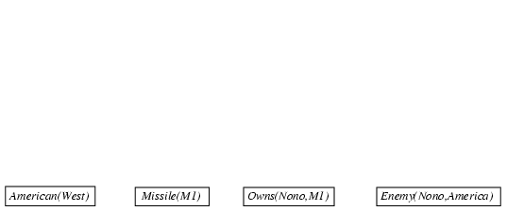
Forward chaining proof

Slide 46
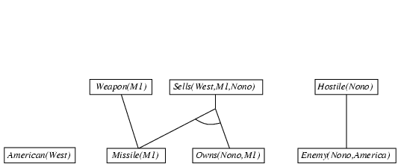
Forward chaining proof

Slide 47
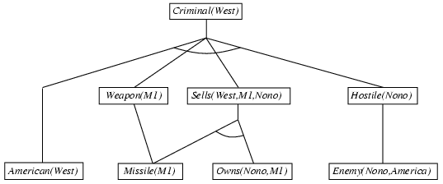
Forward chaining proof

Slide 48
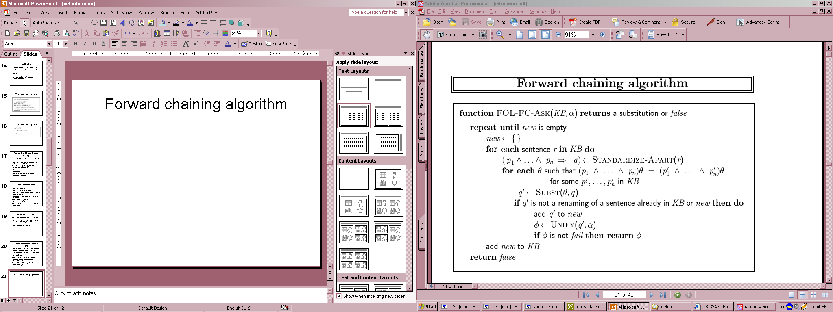
Forward chaining algorithm
Definite clauses 🡪 disjunctions of literals of which exactly one is positive.
p1 , p2, p3 🡪 q
Is suitable for using GMP

Slide 49
Properties of forward chaining
Sound and complete for first-order definite clauses
Datalog = first-order definite clauses + no functions
FC terminates for Datalog in finite number of iterations
May not terminate in general if α is not entailed

Slide 50
Efficiency of forward chaining
Incremental forward chaining: no need to match a rule on iteration k if a premise wasn't added on iteration k-1
⇒ match each rule whose premise contains a newly added positive literal
Matching itself can be expensive:
Database indexing allows O(1) retrieval of known facts
e.g., query Missile(x) retrieves Missile(M₁)
Forward chaining is widely used in deductive databases

Slide 51

Backward chaining example
American(x) ∧ Weapon(y) ∧ Sells(x, y, z) ∧ Hostile(z) ⇒ Criminal(x)

Slide 52
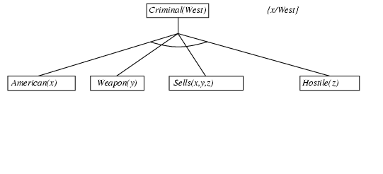
Backward chaining example
American(x) ∧ Weapon(y) ∧ Sells(x, y, z) ∧ Hostile(z) ⇒ Criminal(x)

Slide 53
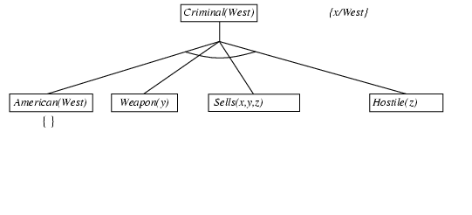
Backward chaining example
American(x) ∧ Weapon(y) ∧ Sells(x, y, z) ∧ Hostile(z) ⇒ Criminal(x)

Slide 54
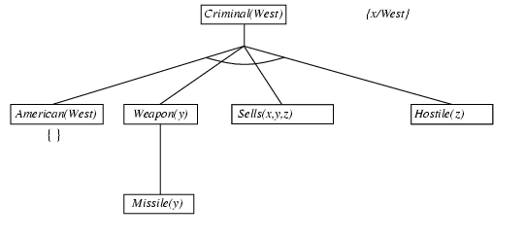
Backward chaining example
American(x) ∧ Weapon(y) ∧ Sells(x, y, z) ∧ Hostile(z) ⇒ Criminal(x)
Missile(x) ⇒ Weapon(x)

Slide 55
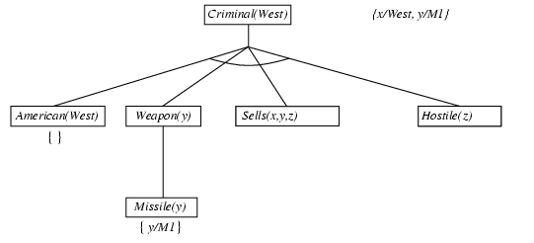
Backward chaining example
American(x) ∧ Weapon(y) ∧ Sells(x, y, z) ∧ Hostile(z) ⇒ Criminal(x)
Missile(x) ⇒ Weapon(x)
∃x Owns(Nono, x) ∧ Missile(x)
Owns(Nono, M₁) ∧ Missile(M₁)

Slide 56
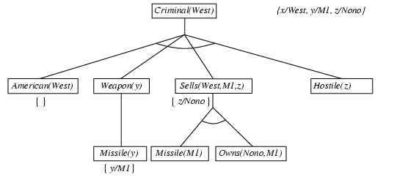
Backward chaining example
American(x) ∧ Weapon(y) ∧ Sells(x, y, z) ∧ Hostile(z) ⇒ Criminal(x)
Missile(x) ∧ Owns(Nono, x) ⇒ Sells(West, x, Nono)

Slide 57
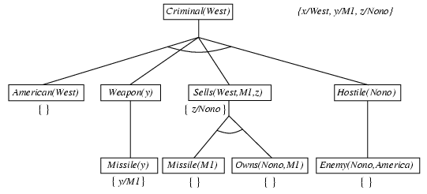
Backward chaining example
American(x) ∧ Weapon(y) ∧ Sells(x, y, z) ∧ Hostile(z) ⇒ Criminal(x)
Enemy(x, America) ⇒ Hostile(x)
Enemy(Nono, America)

Slide 58
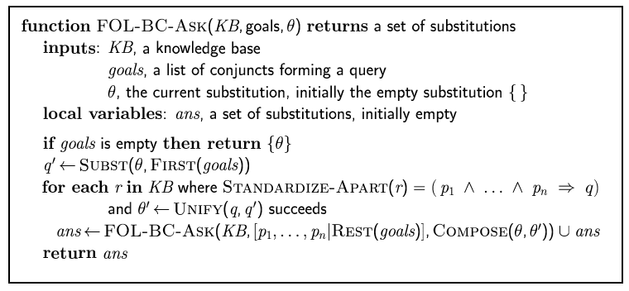
Backward chaining algorithm

Slide 59
Properties of backward chaining
Depth-first recursive proof search: space is linear in size of proof
Incomplete due to infinite loops
⇒ fix by checking current goal against every goal on stack
Inefficient due to repeated subgoals (both success and failure)
⇒ fix using caching of previous results (extra space)
Widely used for logic programming

Slide 60
Inference in FOL
Resolution
‹#›

Slide 61
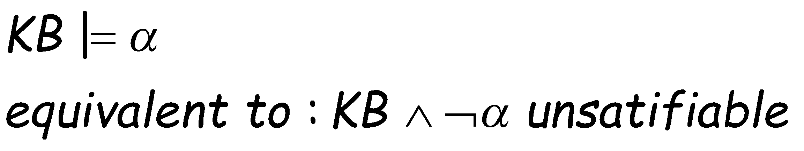
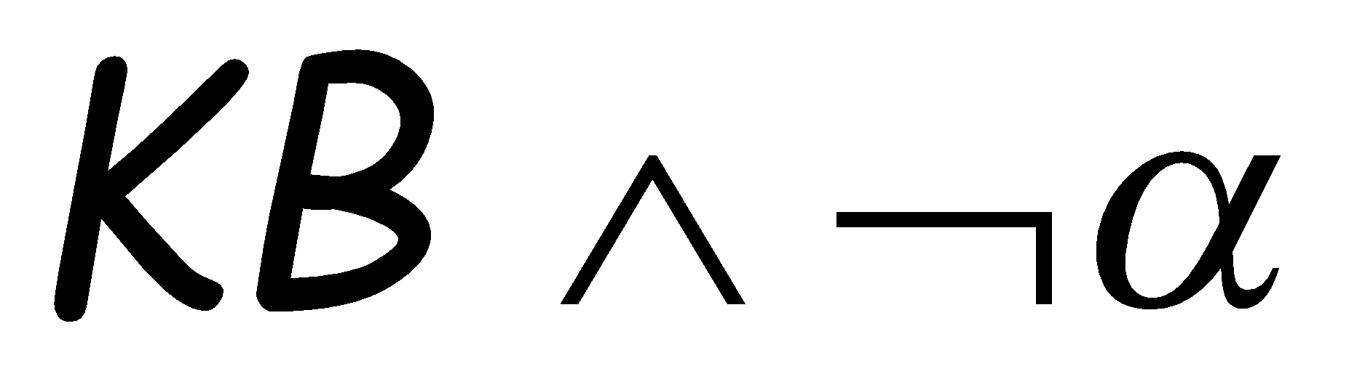
Recall: Propositional Resolution-based Inference
We want to prove:
We first rewrite into conjunctive normal form (CNF).
A “conjunction of disjunctions”
literals
(A ∨ ¬B) ∧ (B ∨ ¬C ∨ ¬D)
Clause
Clause
Any KB can be converted into CNF
k-CNF: exactly k literals per clause

Slide 62
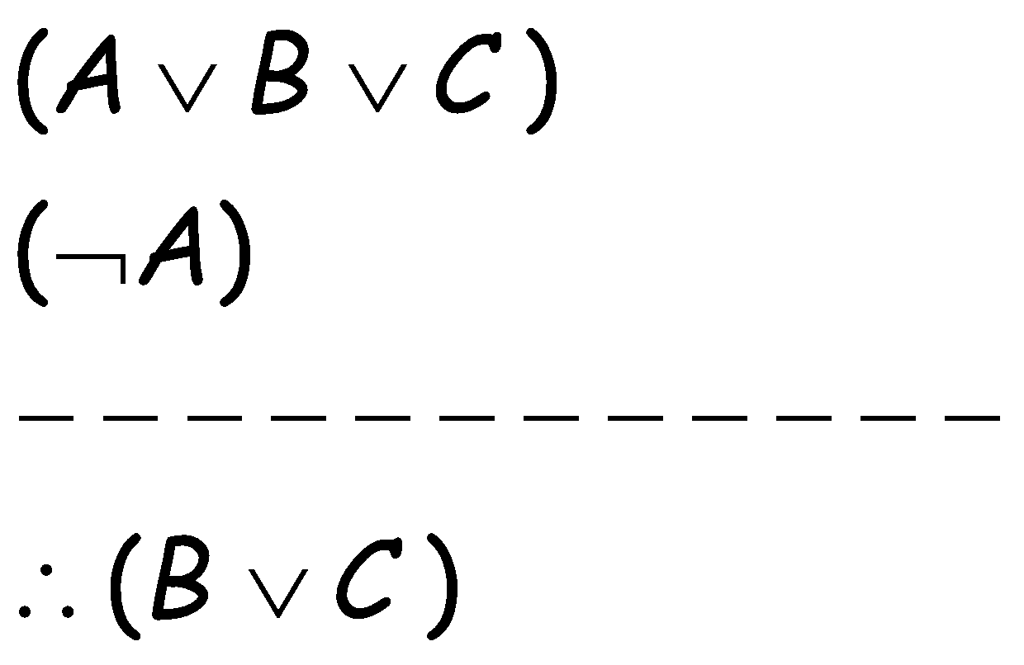
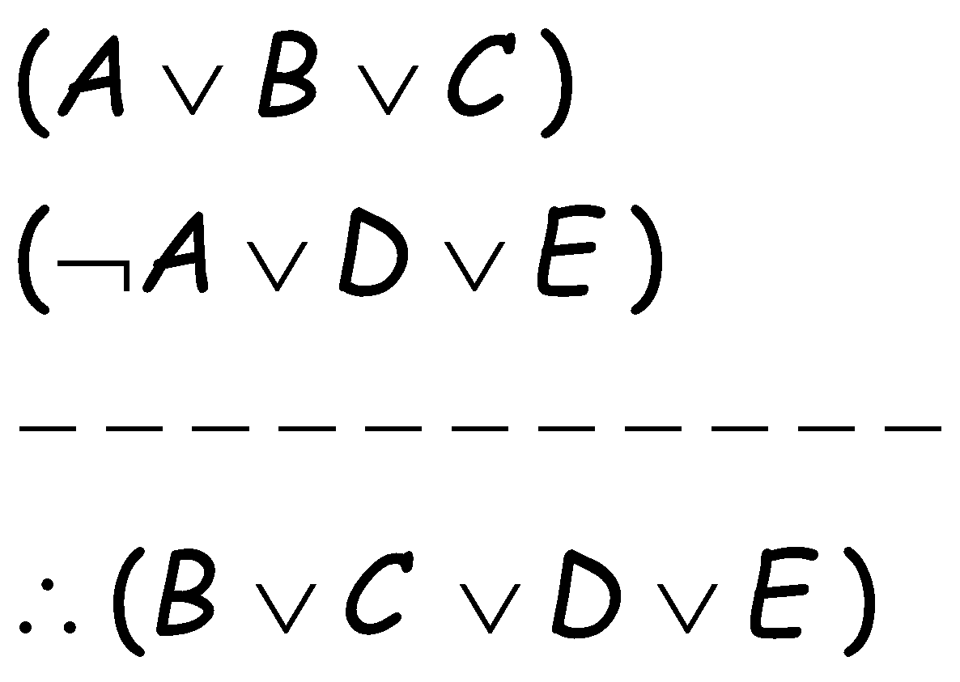
Resolution Examples (Propositional)

Slide 63
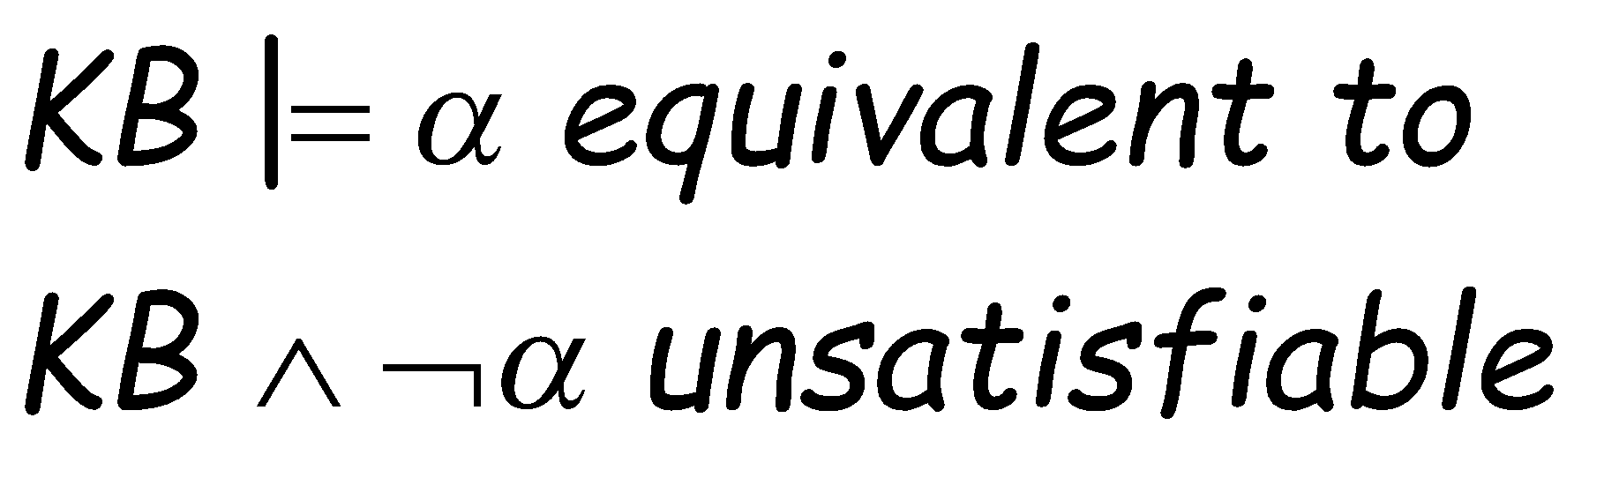

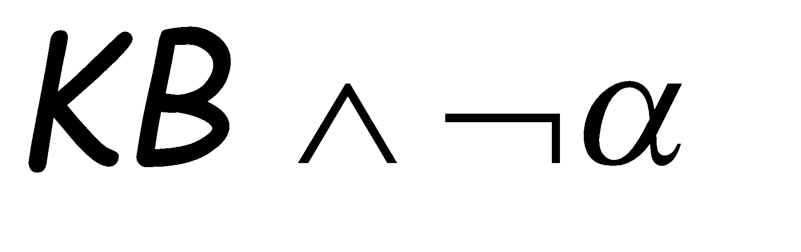
Resolution example
The resolution algorithm tries to prove:
Generate all new sentences from KB and the query.
One of two things can happen:
We find which is unsatisfiable,
i.e. we can entail the query.
2. We find no contradiction: there is a model that satisfies the
Sentence (non-trivial) and hence we cannot entail the query.

Slide 64
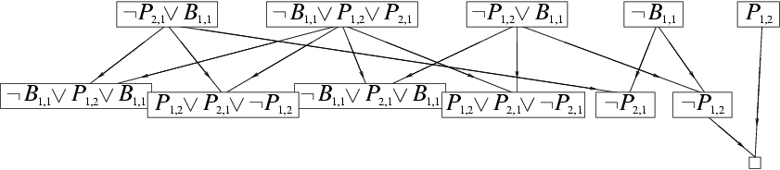
Resolution example
KB = (B_{1,1} ⇔ (P_{1,2}∨ P_{2,1})) ∧¬ B_{1,1}
α = ¬P_{1,2}
True
False in
all worlds

Slide 65
Example Knowledge Base in FOL
... it is a crime for an American to sell weapons to hostile nations:
American(x) ∧ Weapon(y) ∧ Sells(x, y, z) ∧ Hostile(z) ⇒ Criminal(x)
Nono … has some missiles, i.e., ∃x Owns(Nono,x) ∧ Missile(x):
Owns(Nono, M₁) and Missile(M₁)
… all of its missiles were sold to it by Colonel West
Missile(x) ∧ Owns(Nono, x) ⇒ Sells(West, x, Nono)
Missiles are weapons:
Missile(x) ⇒ Weapon(x)
An enemy of America counts as "hostile“:
Enemy(x, America) ⇒ Hostile(x)
West, who is American …
American(West)
The country Nono, an enemy of America …
Enemy(Nono, America)
Can be converted to CNF
Query: Criminal(West)?

Slide 66
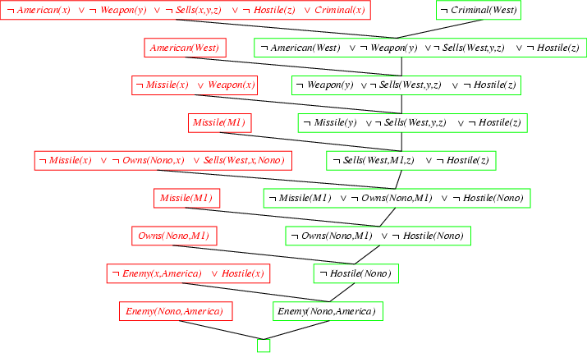
Resolution Proof

Slide 67
Converting FOL sentences to CNF
Original sentence:
Anyone who likes all animals is loved by someone:
∀x [∀y Animal(y) ⇒ Likes(x, y)] ⇒ [∃y Loves(y, x)]
1. Eliminate biconditionals and implications
∀x [¬∀y ¬Animal(y) ∨ Likes(x, y)] ∨ [∃y Loves(y, x)]
2. Move ¬ inwards:
Recall: ¬∀x p ≡ ∃x ¬p, ¬ ∃x p ≡ ∀x ¬p
∀x [∃y ¬(¬Animal(y) ∨ Likes(x, y))] ∨ [∃y Loves(y, x)]
∀x [∃y ¬¬Animal(y) ∧ ¬Likes(x, y)] ∨ [∃y Loves(y, x)]
∀x [∃y Animal(y) ∧ ¬Likes(x, y)] ∨ [∃y Loves(y, x)]
Either there is some animal that x doesn’t like if that is not the case then someone loves x

Slide 68
Standardize variables: each quantifier should use a different one
∀x [∃y Animal(y) ∧ ¬Likes(x, y)] ∨ [∃z Loves(z, x)]
Skolemize:
∀x [Animal(A) ∧ ¬Likes(x, A)] ∨ Loves(B, x)
Everybody fails to love a particular animal A or is loved by a particular person B, which has a wrong meaning entirely
Animal(cat)
Likes(marry, cat)
Loves(john, marry)
Likes(cathy, cat)
Loves(Tom, cathy)
a more general form of existential instantiation.
Each existential variable is replaced by a Skolem function of the enclosing universally quantified variables: ∀x [Animal(F(x)) ∧ ¬Loves(x, F(x))] ∨ Loves(G(x), x)
(reason: animal y could be a different animal for each x.)

Slide 69
Conversion of CNF Cont.
Drop universal quantifiers:
[Animal(F(x)) ∧ ¬Loves(x,F(x))] ∨ Loves(G(x),x)
(all remaining variables assumed to be universally quantified)
Distribute ∨ over ∧ :
[Animal(F(x)) ∨ Loves(G(x), x)] ∧ [¬Loves(x, F(x)) ∨ Loves(G(x), x)]
Original sentence is now in CNF form – can apply same ideas to all sentences in KB to convert into CNF
Also need to include negated query. Then use resolution to attempt to derive the empty clause which show that the query is entailed by the KB

Slide 70
Summary of FOL
Inference in FOL
Grounding approach: reduce all sentences to PL and apply propositional inference techniques.
FOL/Lifted inference techniques
Propositional techniques + Unification.
Generalized Modus Ponens
Resolution-based inference.
Many other aspects of FOL inference we did not discuss in class

Slide 71
Expert Systems (ES)
Definition: an ES is a program that behaves like an expert for some problem domain.
Should be capable of explaining its decisions and the underlying reasoning.
Often, it is expected to be able to deal with uncertain and incomplete information.
Application domains: Medical diagnosis (MYCIN), locating equipment failures,…
‹#›

Slide 72
Expert Systems (ES)
Functions and structure:
Expert systems are designed to lve problems that require expert knowledge in a particular domain → possessing knowledge in some form.
ES are known as knowledge based systems.
Expert systems have to have a friendly user interaction capability that will make the system’s reasoning transparent to the user.
‹#›

Slide 73
Expert Systems (ES)
Functions and structure:
The structure of an ES includes three main modules:
A knowledge base
An inference engine
A user interface
User interface
user
Knowledge
base
Inference
engine
Shell
‹#›

Slide 74
Expert Systems (ES)
Functions and structure:
The knowledge base comprises the knowledge that is specific to the domain of application: simple facts, rules, constraints and possibly also methods, heuristics and ideas for solving problems.
Inference engine: designed to use actively the knowledge in the base deriving new knoweldge to help decision making.
User interface: caters for smooth communication between the user and the system.
‹#›

Slide 75
Expert Systems (ES)
Summary
FOL extends PL by adding new concepts such as sets, relations and functions and new primitives such as variables, equality and quantifiers.
There exist sevaral alternatives to perform inference in FOL.
Logic is not the only one alternative to represent knowledge.
Inference algorithms depend on the way knowledge is represented.
Development of expert systems relies heavily on knoweldge representation and reasoning.
‹#›

Slide 76
References
Chapter 9 of “Artificial Intelligence: A modern approach” by Stuart Russell, Peter Norvig.

Slide 77
Complex Skolemization Example
KB:
Everyone who loves all animals is loved by someone.
Anyone who kills animals is loved by no-one.
Jack loves all animals.
Either Curiosity or Jack killed the cat, who is named Tuna.
Query: Did Curiosity kill the cat?
Inference Procedure:
Express sentences in FOL.
Eliminate existential quantifiers.
Convert to CNF form and negated query.

Slide 78
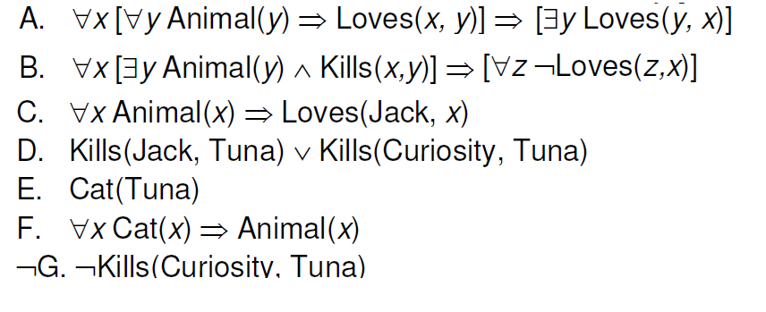
Complex Skolemization Example

Slide 79
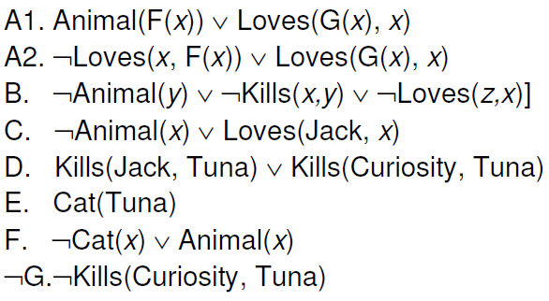
Complex Skolemization Example

Slide 80
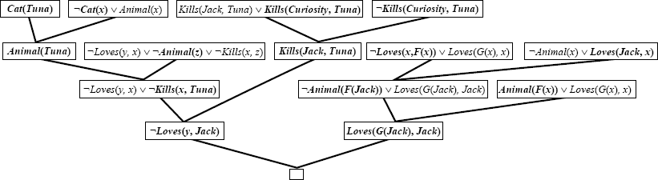
Resolution-based Inference

